Slide 1
Database Testing Tools
Group 20

Slide 2
Group 20
ID
Name
22125031 | Le Quoc Huy
22125032 | Tran Quang Huy
22125047 | Vo Lan
22125064 | Le Huu Nghia

Slide 3
Contents
I
Introduction
II
Testing Process
III
Testing Types
IV
Tools & Demo

Slide 4
I
Introduction
Structured Data
Organized, predefined format
Examples: names, addresses, financial transactions
Used in RDBMS (MySQL, PostgreSQL, Oracle)
Data
facts and information
records, tables, columns, indexes
user input, files, or configuration settings
Unstructured Data
No fixed format, loosely organized
Examples: documents, images, audio, videos
Common in apps with text or user-generated content

Slide 5



I
Introduction
A database is an organized collection of data for easy access and manipulation
Data is structured into tables, rows, columns, and indexes
Tables store data
Database
Functions & triggers handle data processing
Views present data in a readable form

Slide 6

I
Introduction
What is Database Testing?
Ensures the quality, accuracy, and security of data stored in a database
Verifies both the data and the components that interact with it
Important because applications store large amounts of critical data (personal info, financial records, transactions)

Slide 7
I
Introduction
Database Testing key points
Checks schema, tables, triggers, and overall data integrity & consistency
Uses SQL queries to test performance, load, and data behavior
Covers multiple layers: UI → Business Logic → Data Access → Database
Includes tests for data validity, integrity, performance, procedures, and triggers

Slide 8
I
Introduction
Why Database Testing?
Ensure Reliable Software Performance
Prevents monetary losses, decision errors, inefficiencies, and security breaches from poor data integrity.

Slide 9
I
Introduction
Why Database Testing?
Data mapping
Business rules
Verifies front-end to DB field accuracy
Validates constraints, triggers, & procedures via SQL
Data accuracy
Data migration
Confirms correct storage per rules & types
Ensures seamless transfers between systems
Data Security
Data transformation
Tests protections against SQL injection & leaks
Checks ETL rules & system integrations

Slide 10


I
Introduction
Advantages
Disadvantages
Early Error Detection
Manual Complexity
Enhanced Coverage
Automation Cost
Data Protection
Skill Needs
Quality & Security
Maintenance Overhead
Data Durability
Scoping Challenges
Prevents Issues

Slide 11
Contents
I
Introduction
II
Testing Process
III
Testing Types
IV
Tools & Demo

Slide 12
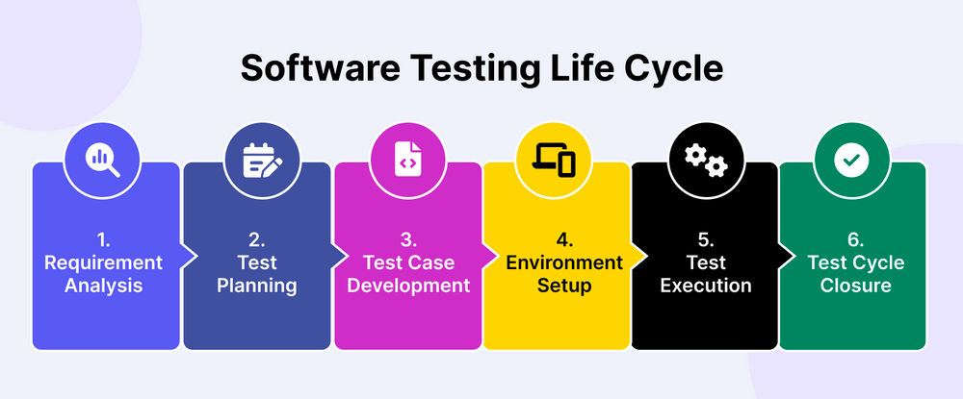
II
Testing Process

Slide 13




II
Testing Process
Environment Setup
Local Database
Populated Development DB
Deployment DB
Used for debugging and initial testing
Shared DB with large data for load simulation
Staging for final pre-production tests

Slide 14
II
Testing Process

Slide 15


II
Testing Process
How to test the Database?
Manual Approach
Automation Approach

Slide 16
II
Testing Process
Manual Approach
01
03
Launch the SQL server and access the query analyzer.
Measure the retrieved data against the anticipated results (Expected Results).
02
04
Compose commands (SQL queries) to retrieve data.
General Procedure
Perform data updates or deletions to evaluate the software application's performance and response.

Slide 17
II
Testing Process
How to test the Database?
Manual Approach
Automation Approach

Slide 18
II
Testing Process
Automation Approach
Fundamental Procedures
Determine Scope: Define key DB areas for automation.
1
Document Outcomes: Record results and detected errors.
5
Develop Test Scripts: Build scripts to interact, execute, and validate tests.
2
Monitor Results: Track patterns like performance issues.
6
Prioritize Test Cases: Identify critical cases for first automation.
3
Validate (Cross-Reference): Cross-check DB results with UI reports.
7
Execute Tests: Run scripts for data retrieval and validation.
4

Slide 19
II
Testing Process
Criteria | Manual Testing | Automated Testing
Nature | Testers manually write and run SQL queries, visually inspecting the results. | Uses scripts and specialized tools to execute test cases and compare results.
When to Use | Best for exploratory testing and complex, hard-to-automate scenarios. | Best for regression testing, performance testing, and tests involving large datasets.
Pros | Flexible, no expensive tools required, can find unexpected bugs. | Fast, repeatable, reliable, saves time in the long run, easily simulates large loads.
Cons | Time-consuming, prone to human error, tedious, difficult with large data volumes. | High initial setup cost, requires programming skills, scripts need maintenance if the DB changes.

Slide 20
II
Testing Process
How to write test cases?
Basic Principles
Understand requirements & business rules
Gather DB details: tables, joins, triggers, procedures, parameters
Write test cases covering different paths & input variations

Slide 21
II
Testing Process
Tracking Information: Test Case ID
Test Description: Objective / Purpose; Steps / Procedures; SQL script (if needed)
Parameters / Data: Input data
Standard Test Case Components
Results: Expected result; Observed result (during execution)
Management Information: Environment (e.g., Local Dev DB); Status (Pass/Fail/etc.); Notes / Comments

Slide 22
II
Testing Process
Data Integrity and Constraint Validation
End-to-End Functional Flow Validation
Test Case Objectives
System Health and Error Checking
Structural and Metadata Validation

Slide 23
Contents
I
Introduction
II
Testing Process
III
Testing Types
IV
Tools & Demo

Slide 24



III
Testing Types
Structural Testing
Functional Testing
Non-functional Testing
Categories

Slide 25
Structural Testing
White-box testing
Schema
Constraints
Internal structure
Tables, columns, relationships
Correct, consistent and reliable
Categories

Slide 26
Structural Testing
Table and Column Validation
Index Testing
Index usefulness & performance impact
Composite indexes, covering indexes, redundant indexes
Correct tables, columns, data types, constraints, defaults.
Data Migration Testing
Database Server Validation
Data consistency before/after migration
Relationships preserved, no corruption
Connectivity, configuration, performance, backups, failover

Slide 27
Table and Column Validation
Verify that all required tables have been created
Validate column lengths match requirements
Check correct column data types
Test naming consistency
Test PRIMARY KEY, FOREIGN KEY, and NOT NULL enforcement
Check for duplicate columns across tables
Validate default column values
Validate unique constraints

Slide 28
Structural Testing
Table and Column Validation
Index Testing
Index usefulness & performance impact
Composite indexes, covering indexes, redundant indexes
Correct tables, columns, data types, constraints, defaults.
Data Migration Testing
Database Server Validation
Data consistency before/after migration
Relationships preserved, no corruption
Connectivity, configuration, performance, backups, failover

Slide 29
Index Testing
What is an Index?
Specialized data structure
Speed up retrieval speed (SELECT)
B-Tree
Slow down INSERT, UPDATE, DELETE

Slide 30
Index Testing
Compare query performance with vs. without indexes
Test queries using covering indexes
Ensure indexes exist on frequently filtered (WHERE) columns
Ensure optimal column order in composite indexes
Check index impact on INSERT/UPDATE/DELETE
Check index usage in JOIN operations
Verify composite indexes match multi-column queries
Remove redundant or unused indexes

Slide 31
Structural Testing
Table and Column Validation
Index Testing
Index usefulness & performance impact
Composite indexes, covering indexes, redundant indexes
Correct tables, columns, data types, constraints, defaults.
Data Migration Testing
Database Server Validation
Data consistency before/after migration
Relationships preserved, no corruption
Connectivity, configuration, performance, backups, failover

Slide 32
Data Migration Testing
What is Data Migration?
Database_1
Database_2

Slide 33
Data Migration Testing
Check relationships and foreign keys after migration
Verify migration of structured & unstructured data
Test migration with large datasets for performance & accuracy
Ensure data types and values remain consistent
Ensure unique constraints and integrity rules remain valid

Slide 34
Structural Testing
Table and Column Validation
Index Testing
Index usefulness & performance impact
Composite indexes, covering indexes, redundant indexes
Correct tables, columns, data types, constraints, defaults.
Data Migration Testing
Database Server Validation
Data consistency before/after migration
Relationships preserved, no corruption
Connectivity, configuration, performance, backups, failover

Slide 35
Database Server Validation
Test server connectivity from the application
Confirm backup & recovery work correctly
Verify authentication & authorization settings
Test failover & redundancy mechanisms
Evaluate server performance using different queries
Review server logs for errors and bottlenecks
Check behavior under high load & concurrency
Ensure compatibility with OS and other software

Slide 36
III
Testing Types
Structural Testing
Functional Testing
Non-functional Testing
Categories

Slide 37
Functional Testing
Data Retrieval Testing
Stored Procedures & Functions Testing
Transaction Testing
Data Manipulation Testing

Slide 38
Data Retrieval Testing
Data Manipulation Testing
Test SELECT * to retrieve all rows
Test INSERT to add new records
Test WHERE to filter specific rows
Test UPDATE to modify existing data
Test JOIN to combine related tables
Test DELETE to remove specific records
Test GROUP BY + HAVING for aggregation
Test combined CRUD operations in one transaction
Test LIMIT/TOP to return limited rows
Test CRUD inside stored procedures /functions

Slide 39
Functional Testing
Data Retrieval Testing
Stored Procedures & Functions Testing
Transaction Testing
Data Manipulation Testing

Slide 40
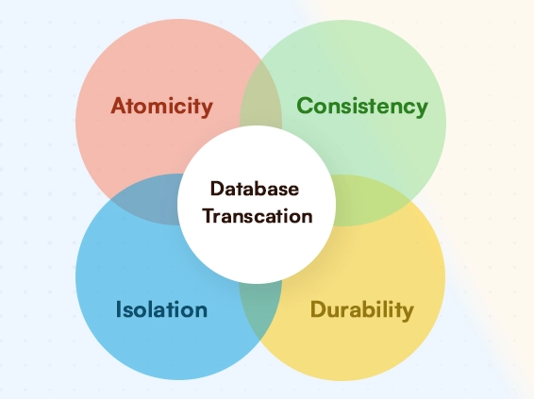
Transaction Testing
What is a Transaction?
Sequence of operations treated as one unit
All operations commit if successful
Any failure trigger rollback of all changes
Ensure ACID properties

Slide 41
Transaction Testing
Test transactions with SELECT/UPDATE/DELETE
Test mixed UPDATE + INSERT with full commit/rollback
Test constraint violations trigger rollback
Test multiple INSERTs committed as one
Test rollback on mid-transaction errors

Slide 42
Functional Testing
Data Retrieval Testing
Stored Procedures & Functions Testing
Transaction Testing
Data Manipulation Testing

Slide 43
Stored Procedures & Functions Testing
What is a Stored Procedure?
What is a Function?
A stored procedure is prewritten SQL code saved for reuse
Similar to a stored procedure but must return a value
Useful for repeated queries or logic
Used for calculations or transformations
Can accept parameters to change behavior
Primarily focuses on computing and returning data
Executes a set of operations when called
Cannot perform major data modifications (e.g., no table updates)
(Optional) Can include complex logic, conditions, loops, etc.

Slide 44
Stored Procedures & Functions Testing
Test with various inputs for correct results
Test nested/recursive procedures
Ensure error handling works properly
Validate function outputs for all input cases
Verify permissions for executing procedures
Test procedures involving multiple tables/complex logic
Check that triggers fire as expected
Ensure procedures maintain ACID

Slide 45
III
Testing Types
Structural Testing
Functional Testing
Non-functional Testing
Categories

Slide 46



Non-functional Testing
Performance Testing
Load Testing
Measures response time, throughput, and resource use under varying loads
Tests performance and responsiveness under expected real-world user loads
01
02
03
04
Stress Testing
Security Testing
Evaluates behavior under extreme or prolonged high loads to find limits
Identifies vulnerabilities and verifies protections against unauthorized access and breaches

Slide 47
Non-functional Testing
Execute a complex query and measure the response time, comparing it with a response time standard
Ensure the response time remains within acceptable limits for all defined user loads.
Gradually increase the number of concurrent users accessing the database and observe how the database handles the increased load and whether performance degrades.
Attempt to access the database with incorrect credentials.
Verify that unauthorized access attempts are denied and appropriate error messages are displayed.
Validate that sensitive data, such as passwords or personal information, is properly encrypted in the database.
Test data retrieval and verify that decrypted data is displayed correctly.
Load the database with a large dataset similar to expected production volumes.
Apply a load that exceeds the expected maximum user load.
Attempt SQL injection attacks by inputting malicious code into queries to see how this system responds.

Slide 48
Contents
I
Introduction
II
Testing Process
III
Testing Types
IV
Tools & Demo

Slide 49


IV
Tools & Demo
What is DBUnit?
Puts databases into a known state between test runs
Supports dataset management using XML, CSV, Excel formats
Provides database assertions to verify expected vs actual data
Enables test isolation by resetting database state

Slide 50
IV
DBUnit
Key Features
Database Assertions
Dataset Import/Export
Multiple Format Support
Database Setup /Teardown
Database Independence

Slide 51
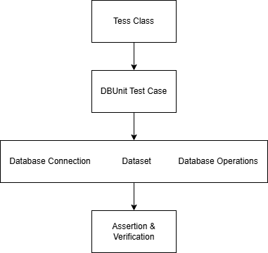
IV
DBUnit
Architecture

Slide 52

IV
Tools & Demo
What is Maven?
Manages project dependencies automatically
Handles build lifecycle (compile, test, package, deploy)
Standardizes project structure
Provides plugin ecosystem for various tasks

Slide 53
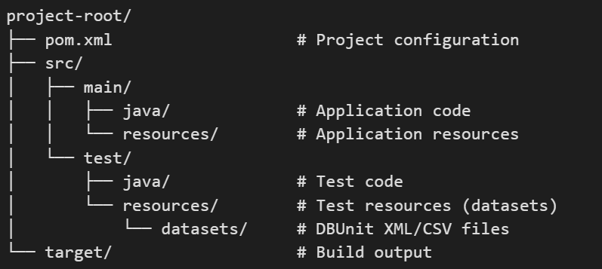
IV
Maven
Maven Project Structure

Slide 54
IV
Maven
Maven Build Lifecycle
Validate project structure
Run unit tests (including DBUnit tests)
Run integration tests
Deploy to remote repository
Validate
Test
Verify
Deploy
Compile
Package
Install
Compile source code
Package compiled code (JAR/WAR)
Install to local repository

Slide 55
IV
Tools & Demo
Manual dataset creation is time-consuming and error-prone
Need realistic data that mimics production patterns
Data Generation Tool
Require large volumes of data for performance testing
Must maintain referential integrity across related tables

Slide 56
IV
Mockaroo
Web-based interface - No installation required
Realistic data - Generates plausible names, emails, addresses
Custom schemas - Define exact table structures
Export formats - XML, JSON, CSV, SQL (perfect for DBUnit)
Why Mockaroo?
Free tier - 1000 rows per dataset
API access - Automate data generation in tests

Slide 57
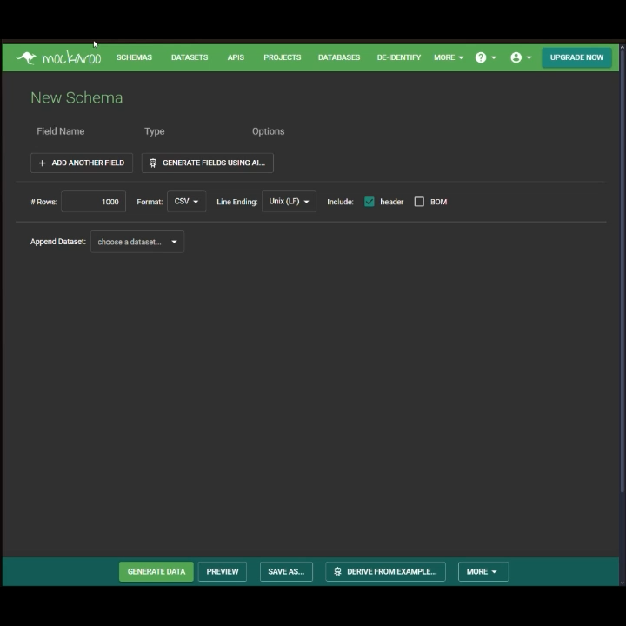
IV
Demo

Slide 58
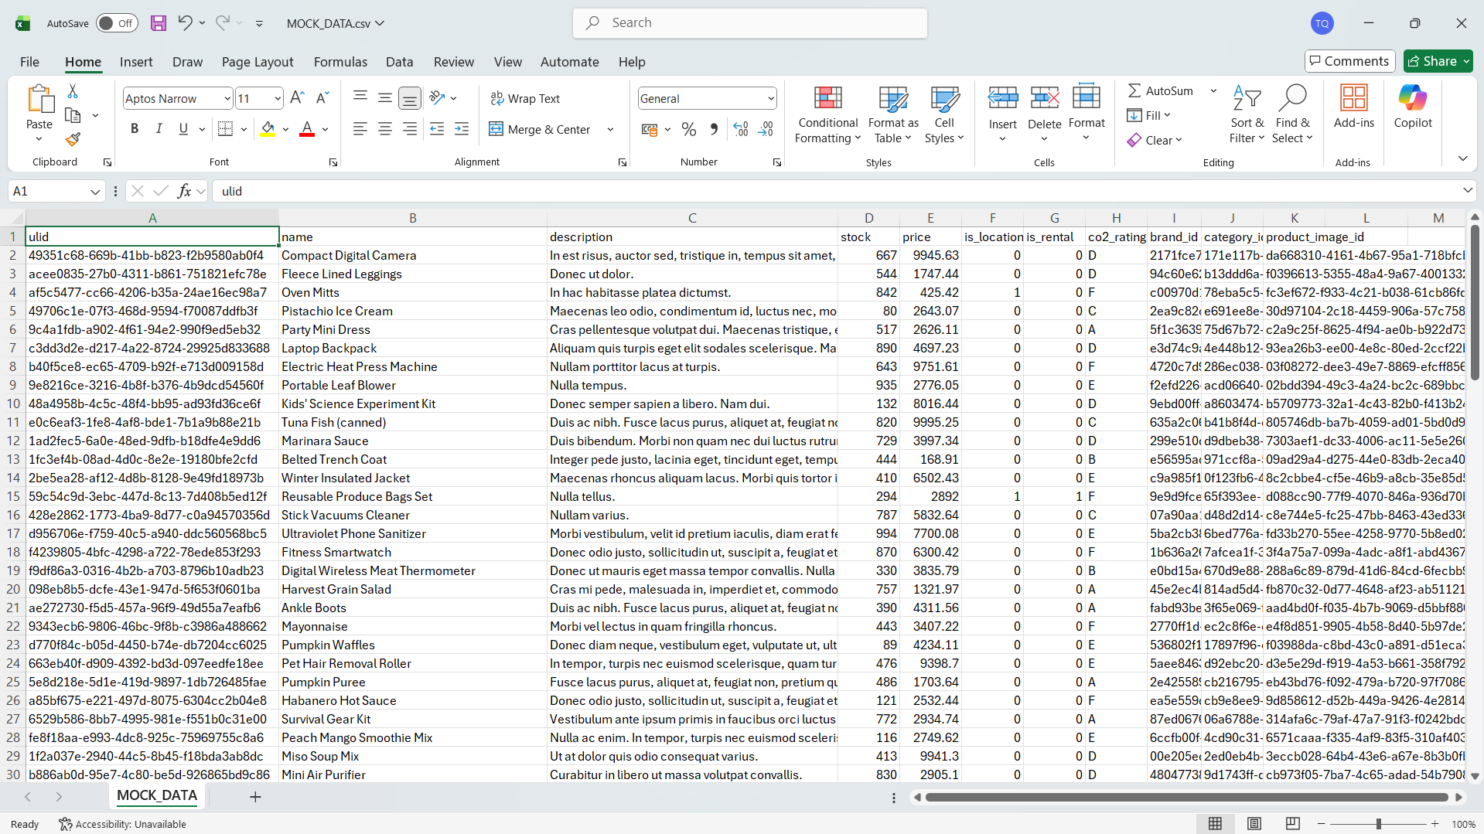
IV
Demo

Slide 59
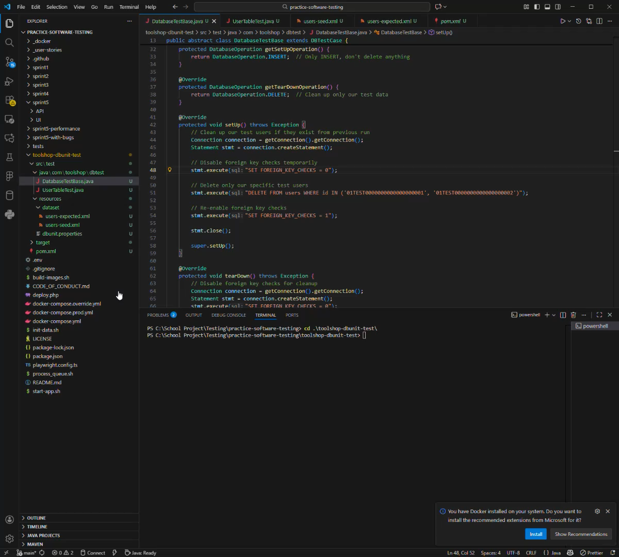
IV
Demo

Slide 60


IV
Tools & Demo – Best Practices
DB Testing
Data Generation

Slide 61
IV
Tools & Demo – Best Practices
DB Testing
Dataset Management
Test Design
Maven Configuration
Keep datasets small
Test isolation
Separate test database
Use realistic data
Clean state
Profile-based config
Version control
Meaningful assertions
Parallel execution
Separate concerns
Error cases
Continuous integration
Document structure
Performance
Test coverage

Slide 62
IV
Tools & Demo – Best Practices
DB Testing
Data Generation

Slide 63
IV
Tools & Demo – Best Practices
Data Generation
Data Consistency
Realistic Distributions
Maintain Referential Integrity
Version Control
Performance Considerations

Slide 64
Thank You For Listening!

